Slide 1
US Air Force Research
Jordan Reynolds | Alabama A&M University
Dr. Yujian Fu

Slide 2
Formal Methods: Temporal Logic
Formal methods is a way of taking subjective language, and applying a logical mathematical expression to it, in an effort to create specification
(Uniquely applicable to software and hardware design)
My research has focused on Temporal logic, a form of reasoning and defining (future) variables
Syntax:
Always (◻)
- Eventually (◊)
- Next (◯)
- Until (U)
- And (^)
- Or (V)
- Not (￢)

Slide 3
Semantics
Labeled transition systems (practical specification patterns)
Formal logic can quickly become in-depth with the inclusion of additional syntax

Slide 4
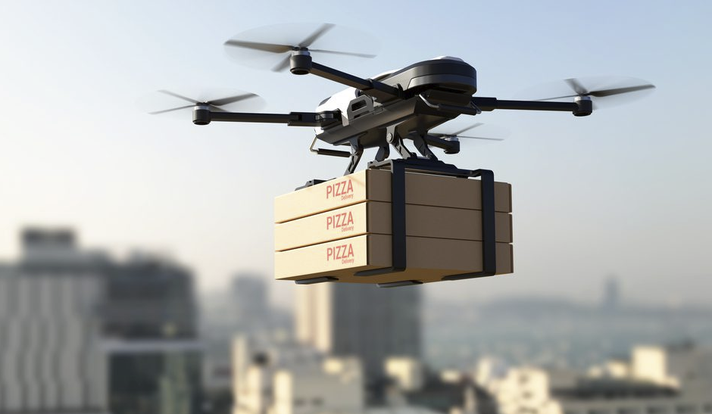
Case Study
Application of Temporal Logic in real life scenarios
Develop a pizza delivery system using quadcopters for a football event.
There are three types of flavors. Assuming all pizza are available in Engineering building
The quadcopter starts from engineering building ETB
Each flight will have two stops, first one is at university quad, second stop is at Lewis Stadium
A quadcopter will deliver one flavor of pizza each flight.

Slide 5
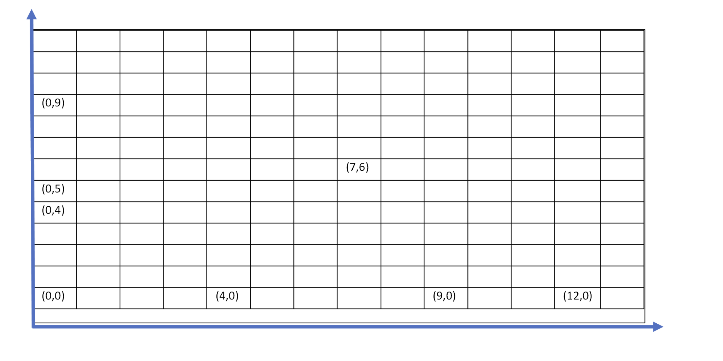
Properties
Quadcopter Properties
Pizza Properties
System/Program Properties

