Slide 1
Air Force/Drone Research
Jordan Reynolds | Alabama A&M University
Dr. Yujian Fu

Slide 2
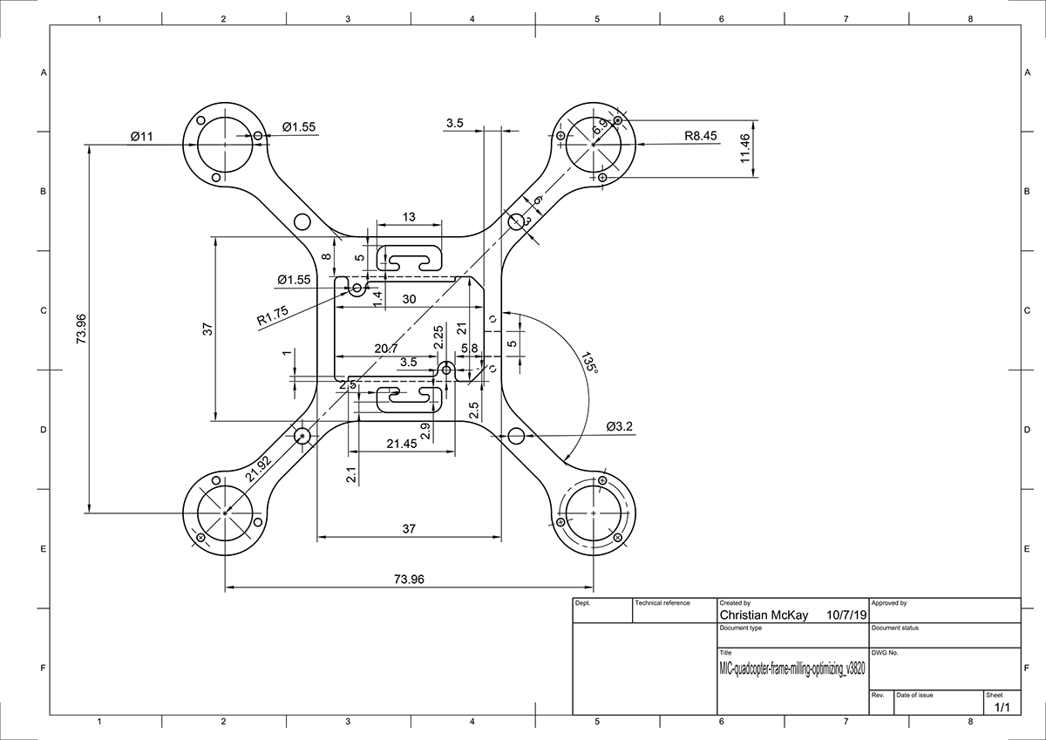
Drone Project
Our project consists of a computer & mechanical engineering portion of design and hardware. To establish a detailed design of the drones components there must first be research into the fundamentals
My research has focused on drone based Dynamics, and engineering flow structures

Slide 3
Drone Dynamics
W1
W3
F1
F3
F4
F2
mg
W2
W4
Drone Dynamics: is the study of small, mobile, unmanned land or sea vehicles, and the engineering behind their basic functions
Drones come in all shapes and sizes, starting from the monocopter, leading to the octocopter. And propellers may have 2-5 blades each (any higher and propeller weight diminishes benefits of increased lift)
My research specifically focuses on Quadcopters, which are drones that have four arms, each with a motor and a set of propellers.

Slide 4
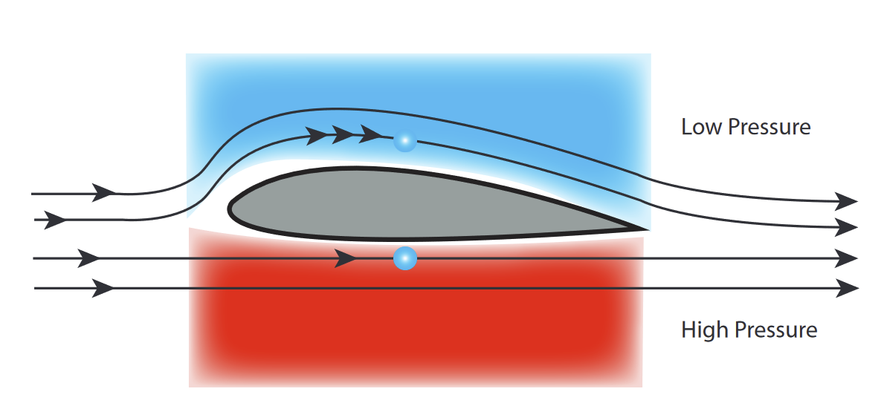
Dynamics Application
Quadcopters consist of motors, a microcontroller (connected to sensors Ex: Gyroscope), a receiver, and 4 propellers.
Propellers are the most important part of a drone, they generate a lift force using Airfoils principle
For a quadcopter to fly, lift force needs to be greater than its weight (L > W), when (L = W) the quadcopter will hover, when (L < W) the quadcopter will decrease altitude.

Slide 5
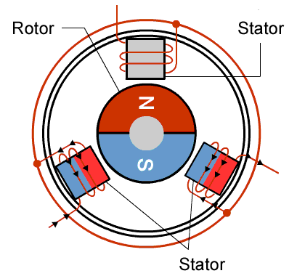
Application (cont.)
Our drone utilizes Brushless DC motors, which function by using stationary stators that charge a magnet (rotor) on the inside causing it to rotate
Based on Newton's 3rd Law, as the rotor spins the stator receives an equal and opposite amount of torque, therefore to counteract this reaction, two blades need to be spun counterclockwise (this creates a net 0 angular momentum)
Roll
Yaw
All basic flight functions of a drone (such as: yaw, pitch, roll) can be made through the manipulation of the lift force and angular momentum force
F3
F1
mg
F3
F1
mg
F2
F4
F2
F4

Slide 6
References
Flynt, Joseph. “Types of Drone Propellers: Everything You Need to Know.” 3D Insider, 15 Apr. 2020, https://3dinsider.com/types-of-drone-propellers/
“Drone Propellers Explained: Detailed Beginner's Guide to Drone Anatomy.” Drone Propellers Explained: Detailed Beginner's Guide To Drone Anatomy – The Corona Wire,https://www.thecoronawire.com/drone-propellers-explained-detailed-beginners-guide-to-drone-anatomy/.
Mishra, Ashish. “Different Types of Drone Frames: Monocopter to Octocopter.” Different Types of Drone Frames in 2022: Monocopter to Octocopter, 27 Dec. 2021, https://circuitdigest.com/article/different-types-of-drone-frames-monocopter-to-octocopter.
“NASA: Aeronautics Research Mission Directorate.” Principles of Flight: Foam Wing, https://www.nasa.gov/sites/default/files/atoms/files/foam_wing_k-12.pdf

