Slide 1
Temporal Logic Based Reinforcement Learning on AirSim for Multiple Drone Collaboration
Carlan Jackson
Oct 17, 2022

Slide 2
Presentation Outline
Great Guidelines & Opportunity for Learning…
Python from beginning to Proficiency
2. Math Concepts and Theories
3. Microsoft Airsim - Smart Platform for UAVs
4. Temporal Logic
5. Intro to SLAM Algorithm

Slide 3
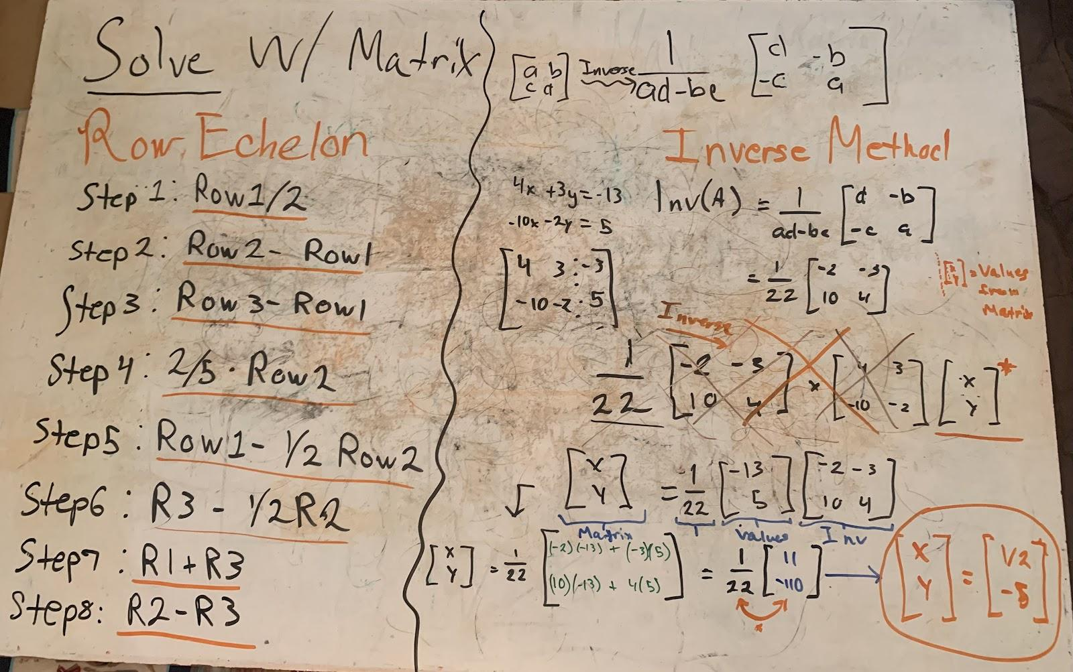
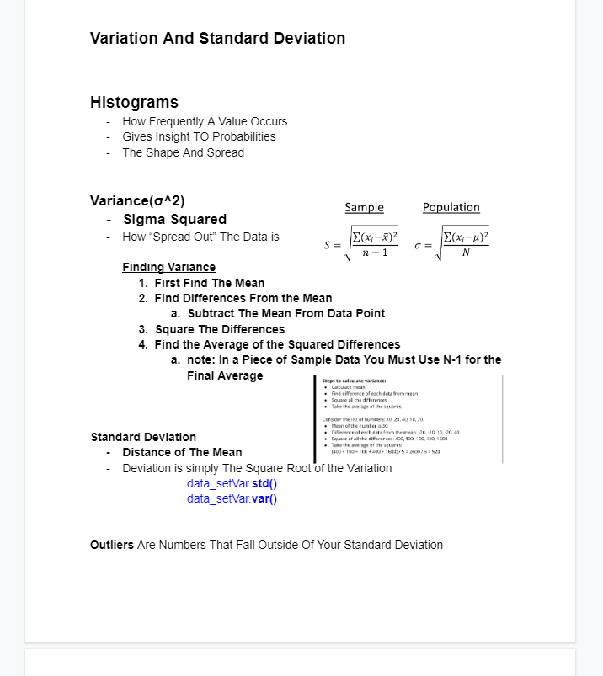
Math Concepts and Theories
Linear Algebra
Vector/Matrix Manipulation
Systems of Equations
Linear Regression
Statistics
Variance
Probability
Standard Deviation

Slide 4
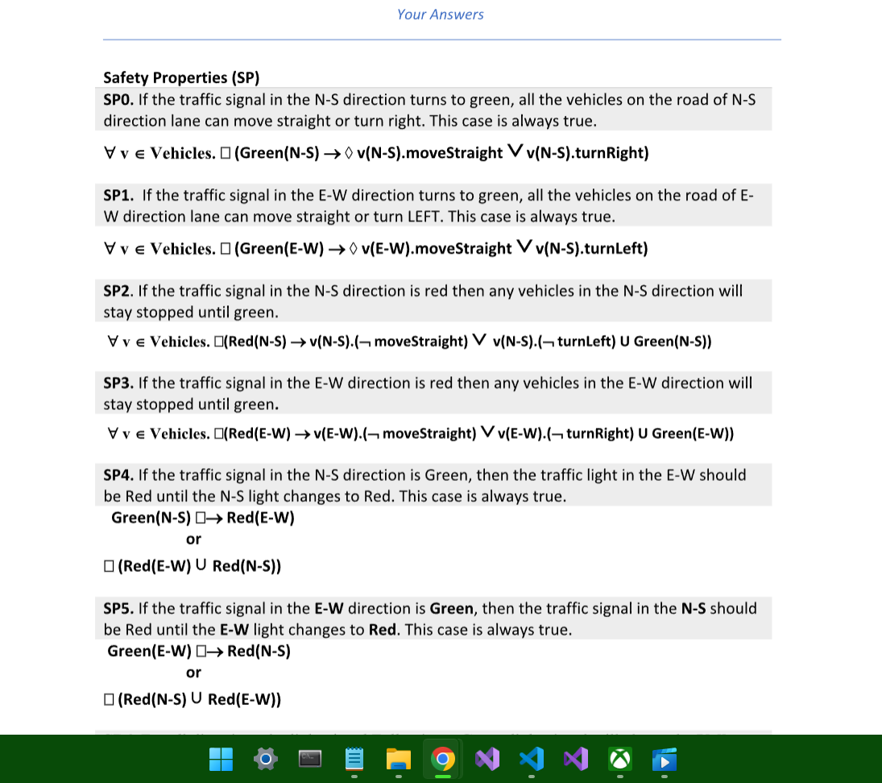
Temporal Logic
Temp Logic is a Linear Time Based System of Semantics to make Decisions
Complex Systems of Action(a), States(s), and Policy(π), using RL inspired concepts
Uses Liveness and Safety Properties to Ensure Consistent Path Planning
Uses Until, Eventually, or Always to Denote consistent Linear Time Logic
Implementat Temporal Logic onto our Autonomous Systems
Using RL framework to synthesize control policies for multi drone systems

Slide 5
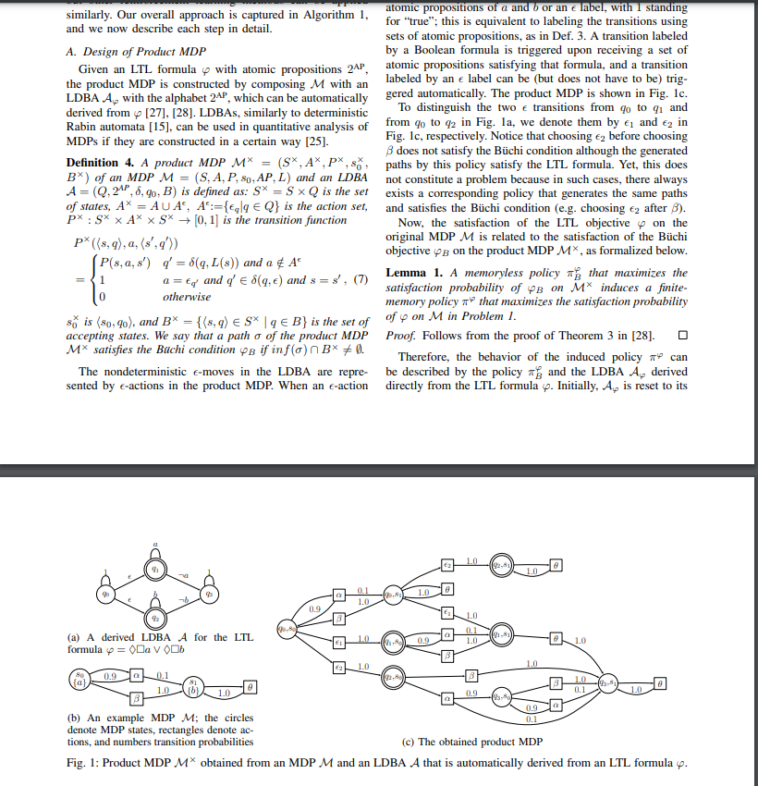
Python from Beginning to Proficiency
Use of Built in Modules:
Pandas,
Numpy,
MatPlotLib, etc.
Jupyter Notebook & Google Colab
Object Oriented Programming
Reinforcement Learning w/ Python
Neural Networks
Q-Learning
Modeling Training and Policy Checking
Markov Decision Process
TensorFlow

Slide 6
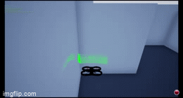
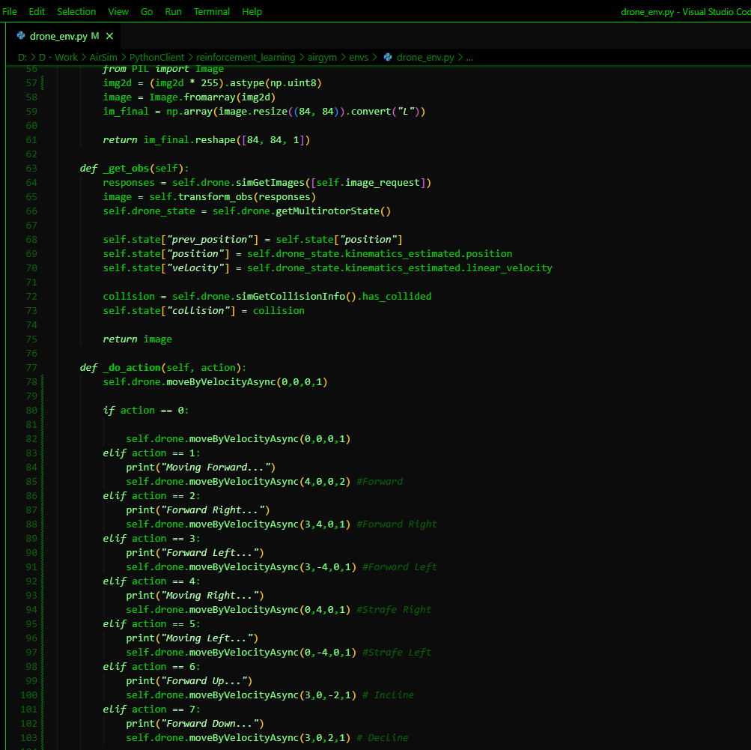
Microsoft Airsim - Smart Platform for UAVs
Created By Microsoft in 2017
Airsim is an open source simulator for drones, cars, and other autonomous vehicle systems.
Simulation platform for Ai and RL Research fueled by the Unreal Engine & Git Repository
Uses Image Collection And Drone Sensors
Building & Testing Custom Environments
Provides Python API Control for Primary Tasks:
Collision Avoidance
Object Detection
Path Planning

Slide 7
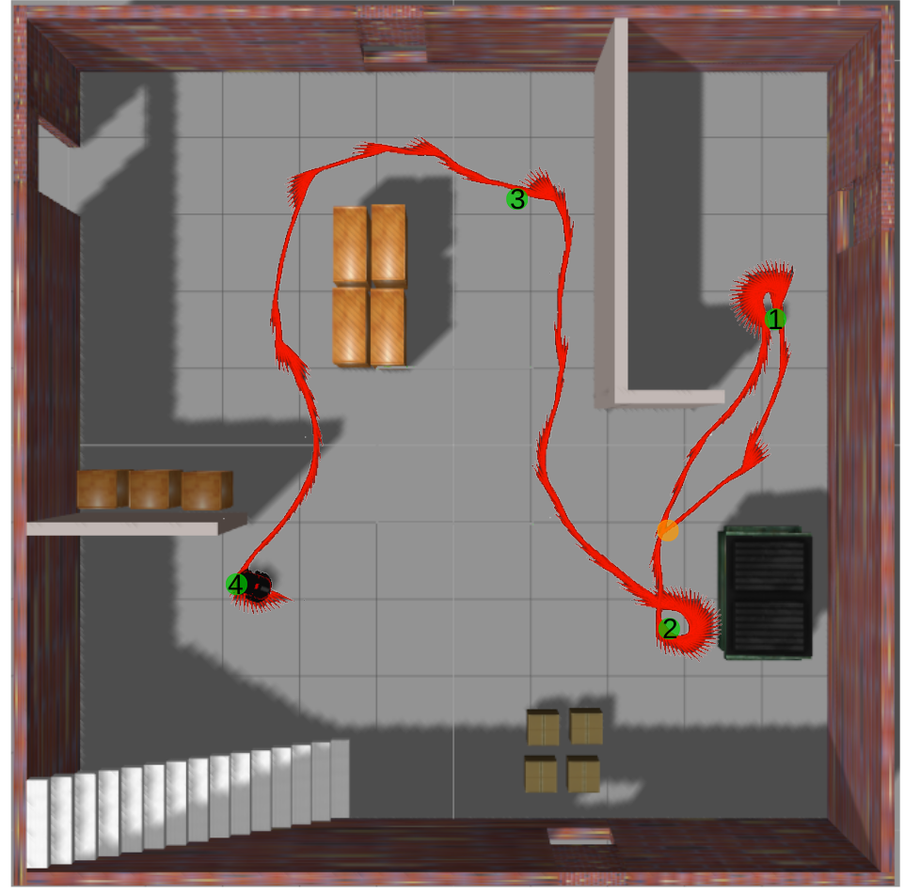
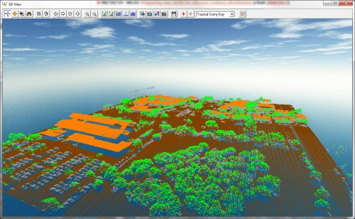
Intro to SLAM Algorithm
Simultaneous Localization And Mapping
Method used for UAV Systems to map out Unknown Environments
SLAM Uses Image Analysis or Lidar Sensing to determine the features of its Environment (Feature Extraction)
Implement SLAM to improve Primary Tasks

