Slide 1
Temporal Logic Based Reinforcement Learning on AirSim for Multiple Drone Collaboration
Carlan Jackson
Nov 30, 2022

Slide 2
Semester of Learning…
Last Time
Previous Slides
Since Then(Videos, Paper)
MDP
Automaton
Buchi
NASA Minds Competition
Preliminary Draft Review
What's Next
Applied Control Systems(Udemy)
Image Analysis
Simulation Design(NASA)

Slide 3
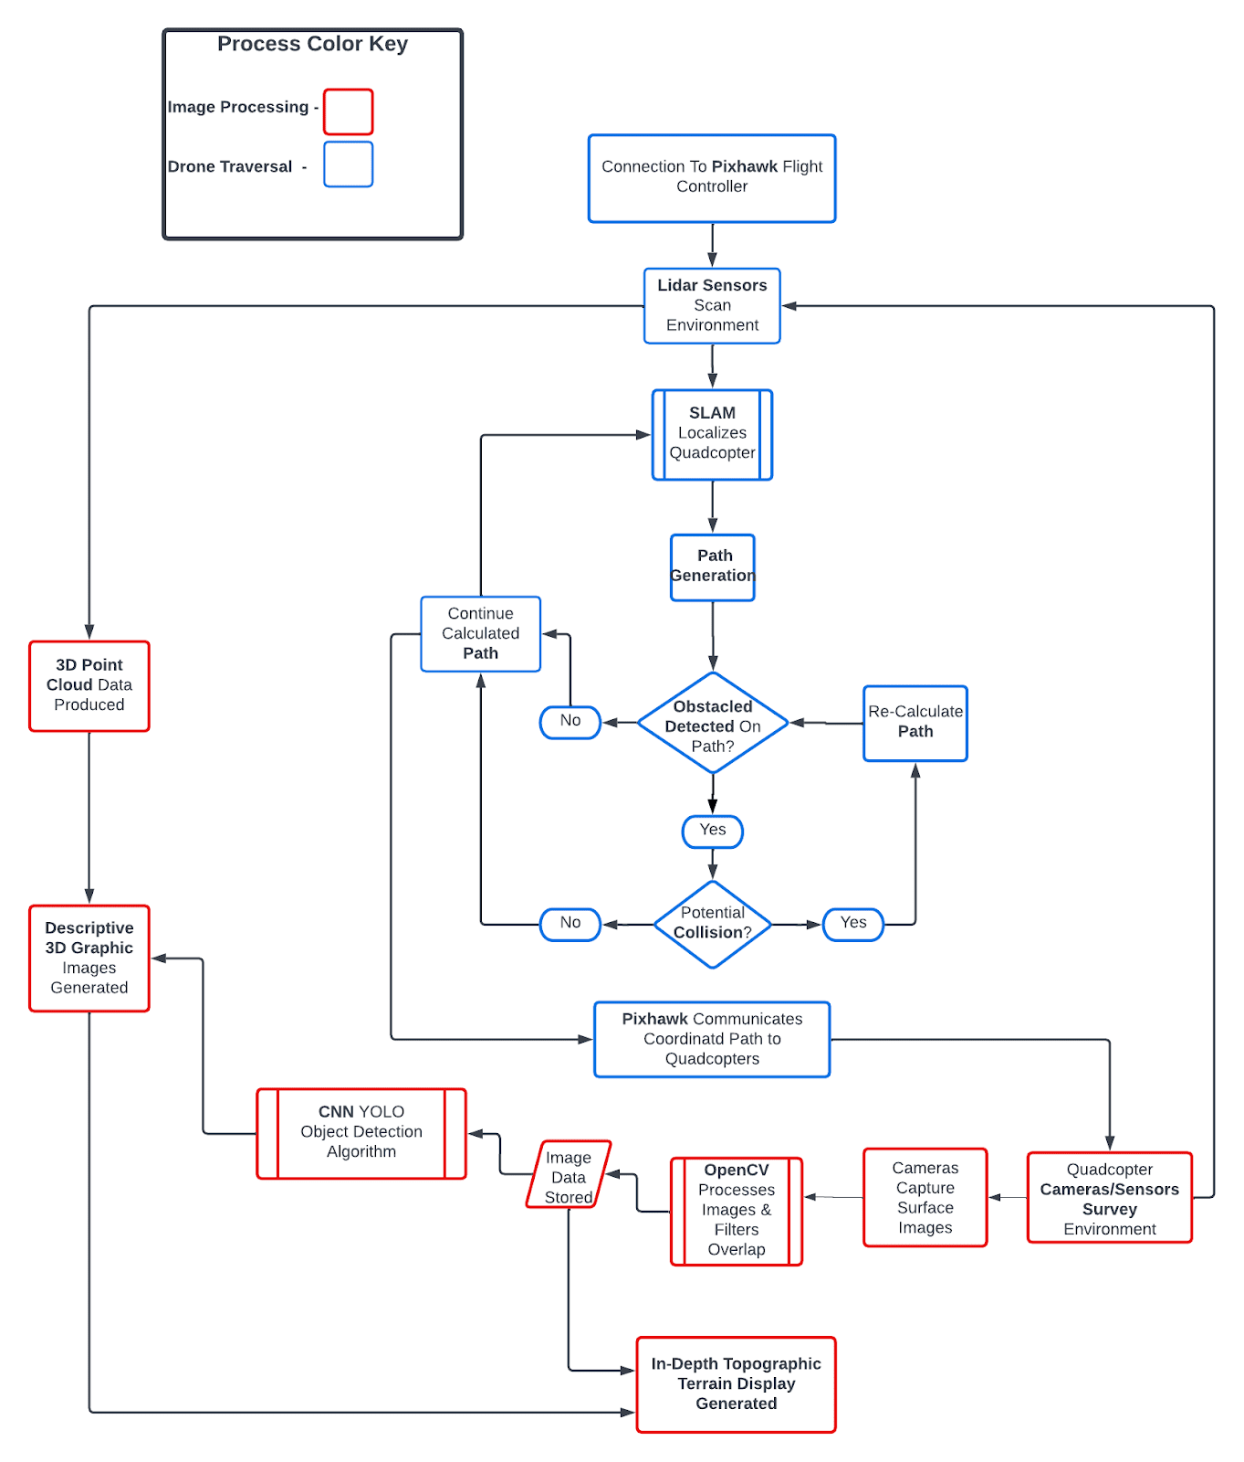
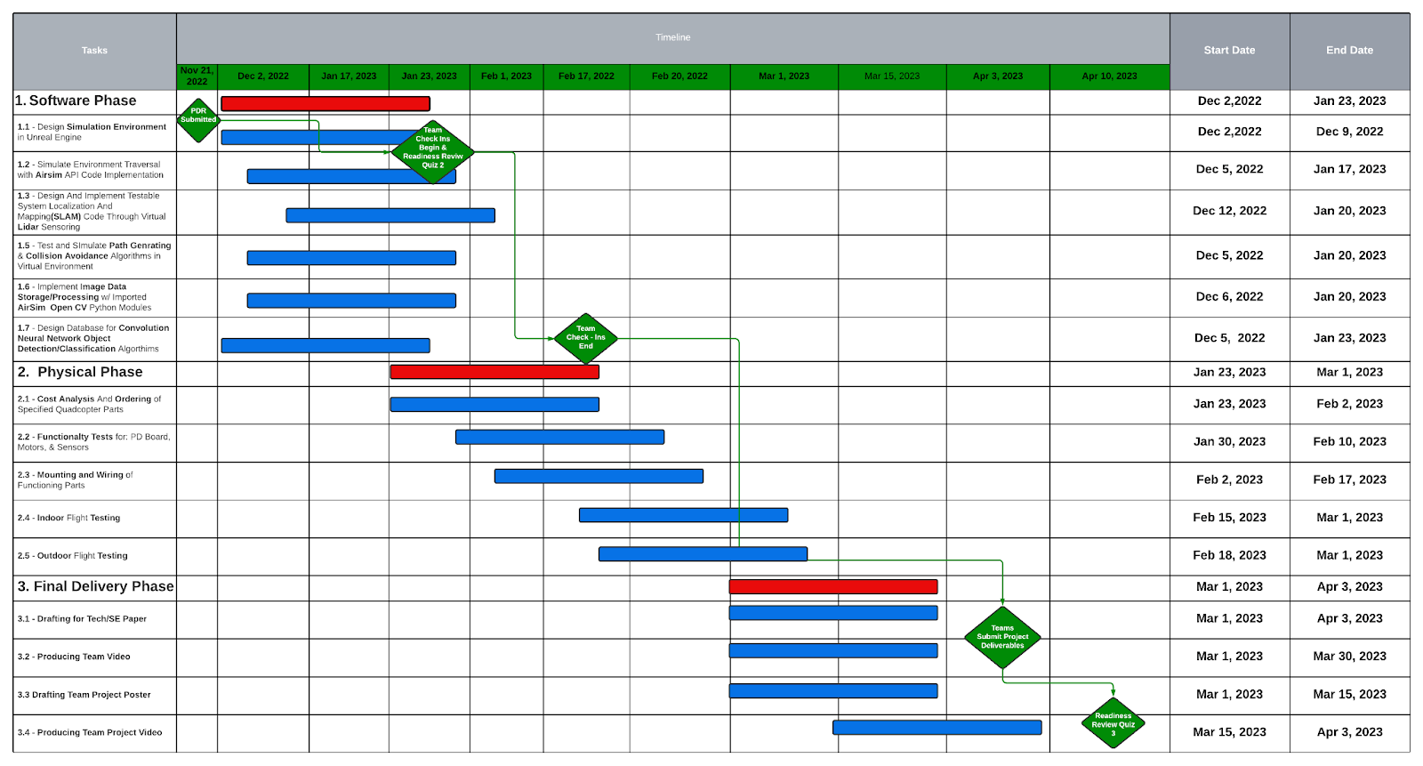
Since Last Time Cont…
NASA Minds Competition
Student Designed Research Project for NASA Space Exploration
Focused in Lidar Based Imaging & UAV Traversal
Opportunity For Technical Experience
Guidelines in Research/Application in Ai Concepts
Completed Preliminary Design Review
Software Design Workflow
Schedule Design
Technical Writing
more…

Slide 4
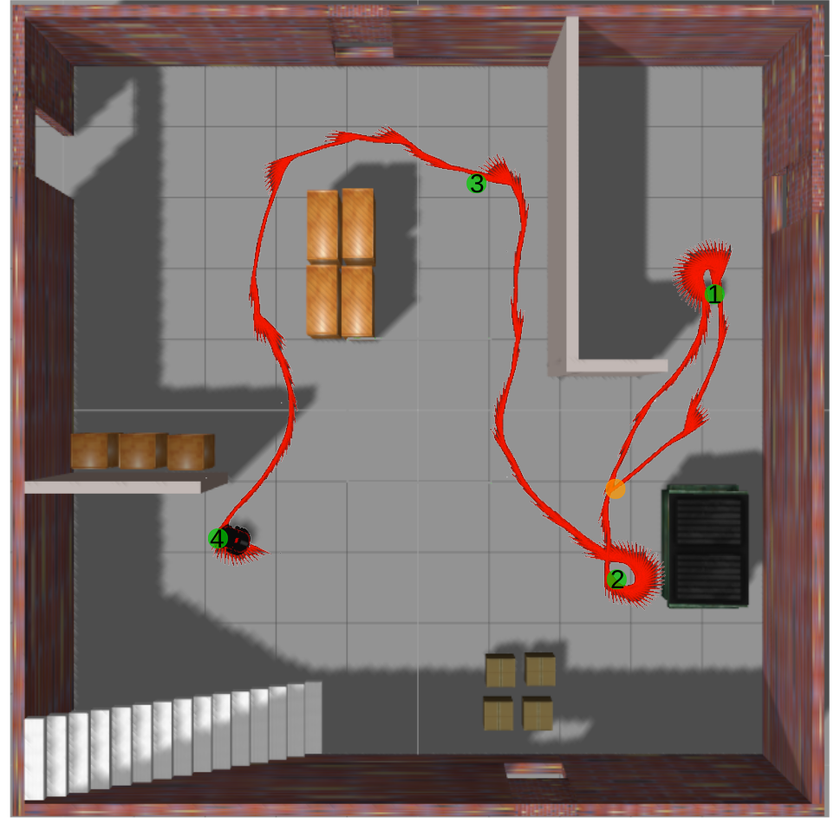
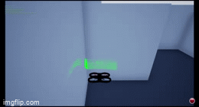
Last Meeting..
Initial Learning Guidelines
Python from beginning to Proficiency
Microsoft Airsim - Smart Platform for UAVs
Temporal Logic
Intro to SLAM Algorithm

Slide 5
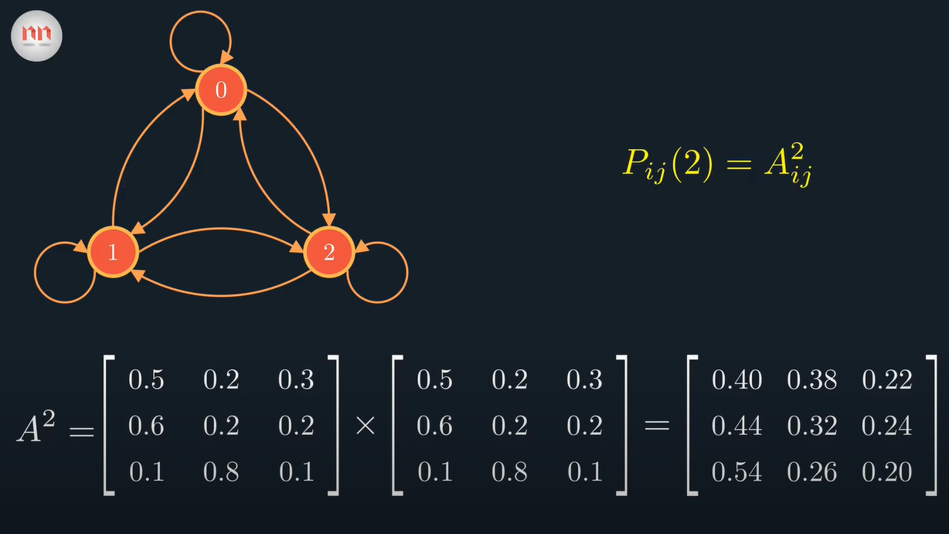
Since Last Time…
Model & Policy Checking Concepts
Markov Decision Process
Markov Chains
State Transitions
Automaton
Stochastic Environments
Buchi Automata
State/Action Acceptance
Probabilities

Slide 6
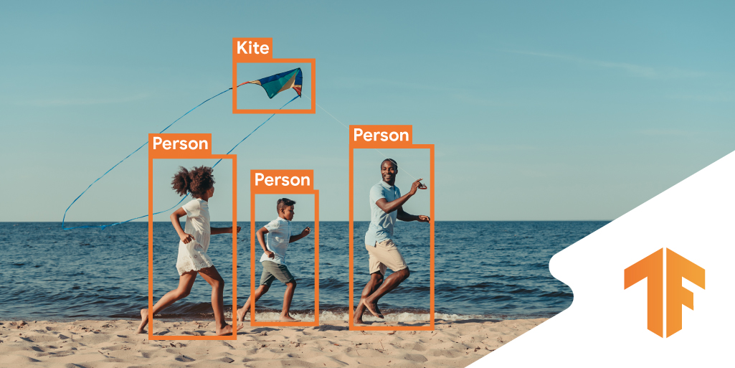
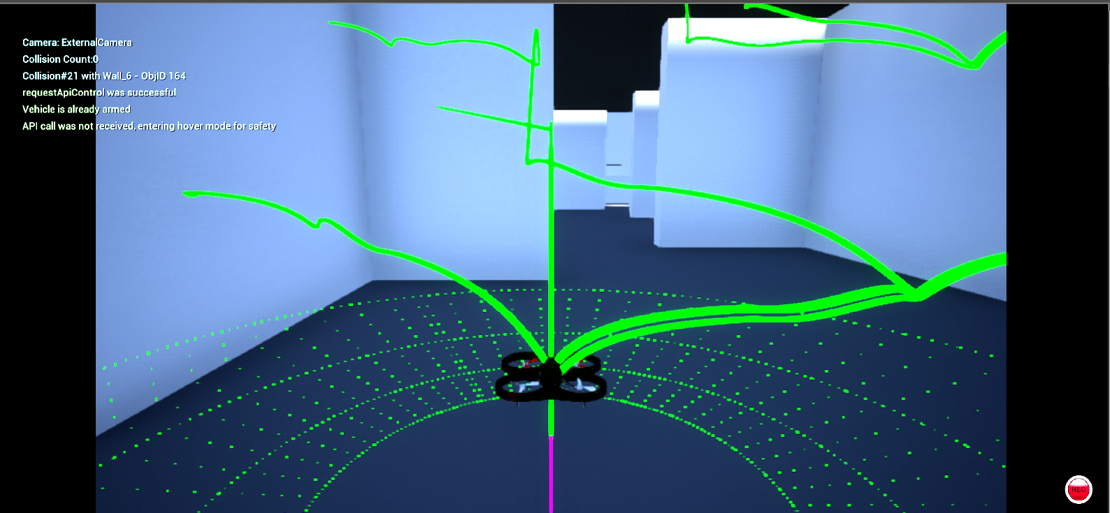
What's Next…
Applied Control Systems(Online Course)
Model Prediction
State Space Mathematical Modeling
3D Dynamics & Control Synthesis
Self Driving Vehicles
Image Processing
Python Packages
Object Detection
Computer Vision
Convolutional Neural Networks
Simulation Design For NASA Research
Unreal Engine Environment Design for UAV Testing
Refresh/Implement Airsim API

